Slide 1
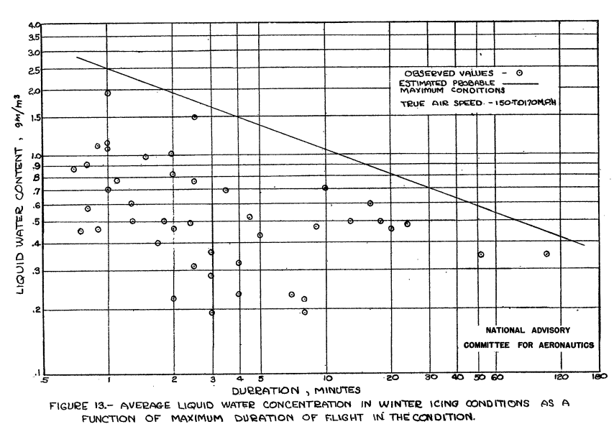
Apparent highest value in stratus clouds
Value selected

Slide 2
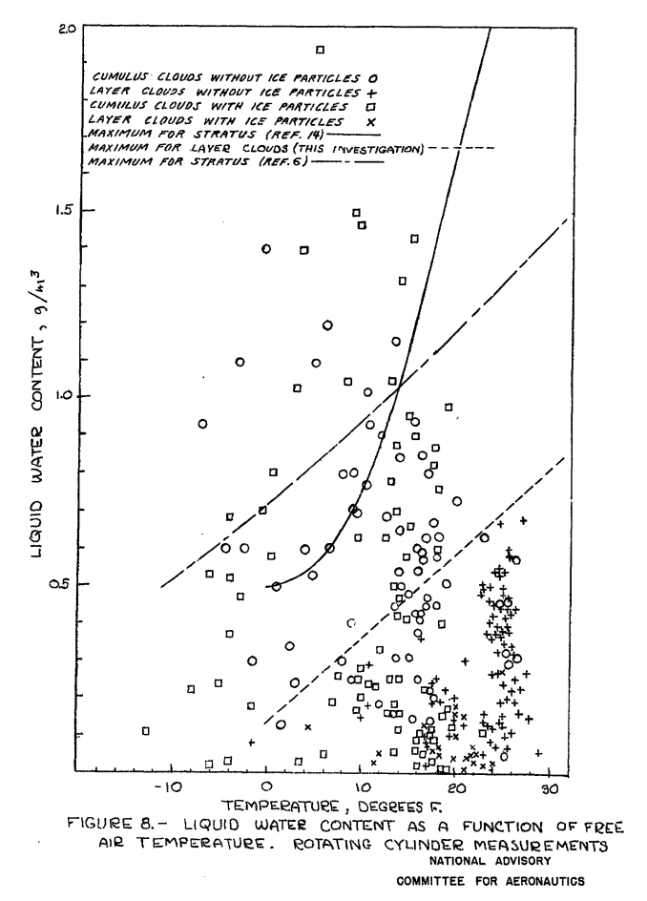
Value selected

Slide 3
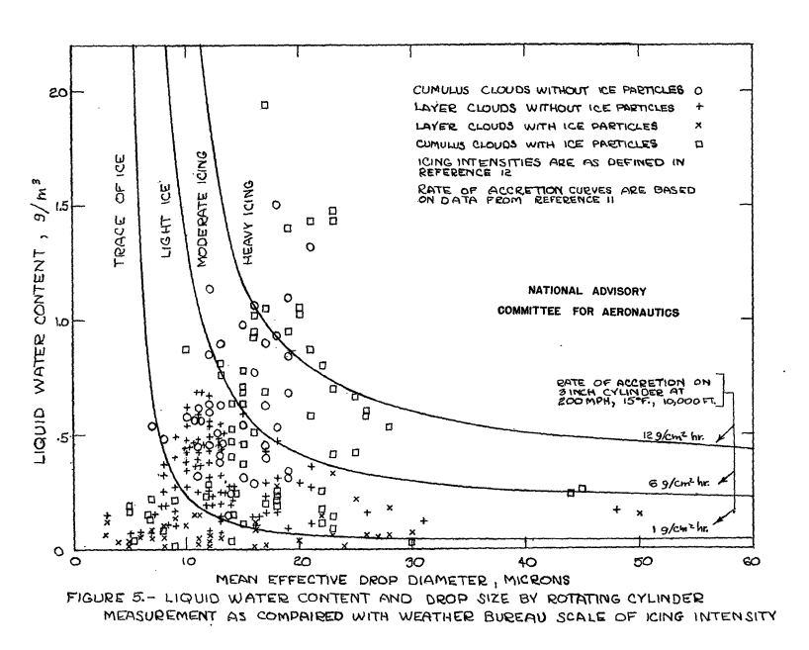
Value selected

